Slide 1

Data Structures and Algorithms
Decentralized Transaction Verification and Storage System (Blockchain)
Team Members :
Shweta Jadhav – 612303071
Janhavi Jain – 612303073
Gauri Kale – 612303078

Slide 2
What is a Blockchain ?
Blockchain is a shared, immutable ledger that facilitates the process of recording transactions and tracking assets in a business network.
Features of Blockchain :
Immutability : ensures data cannot be altered, enhancing security and transparency.
Decentralization : Eliminates the need for a central authority, providing greater security and transparency.
Enhanced Security : achieved through encryption, hashing, and consensus mechanism
Distributed ledgers : make all transaction details visible and tamper-proof.
Data can not be corrupted.
Transparancy.
Applications : Cryptocurrency

Slide 3
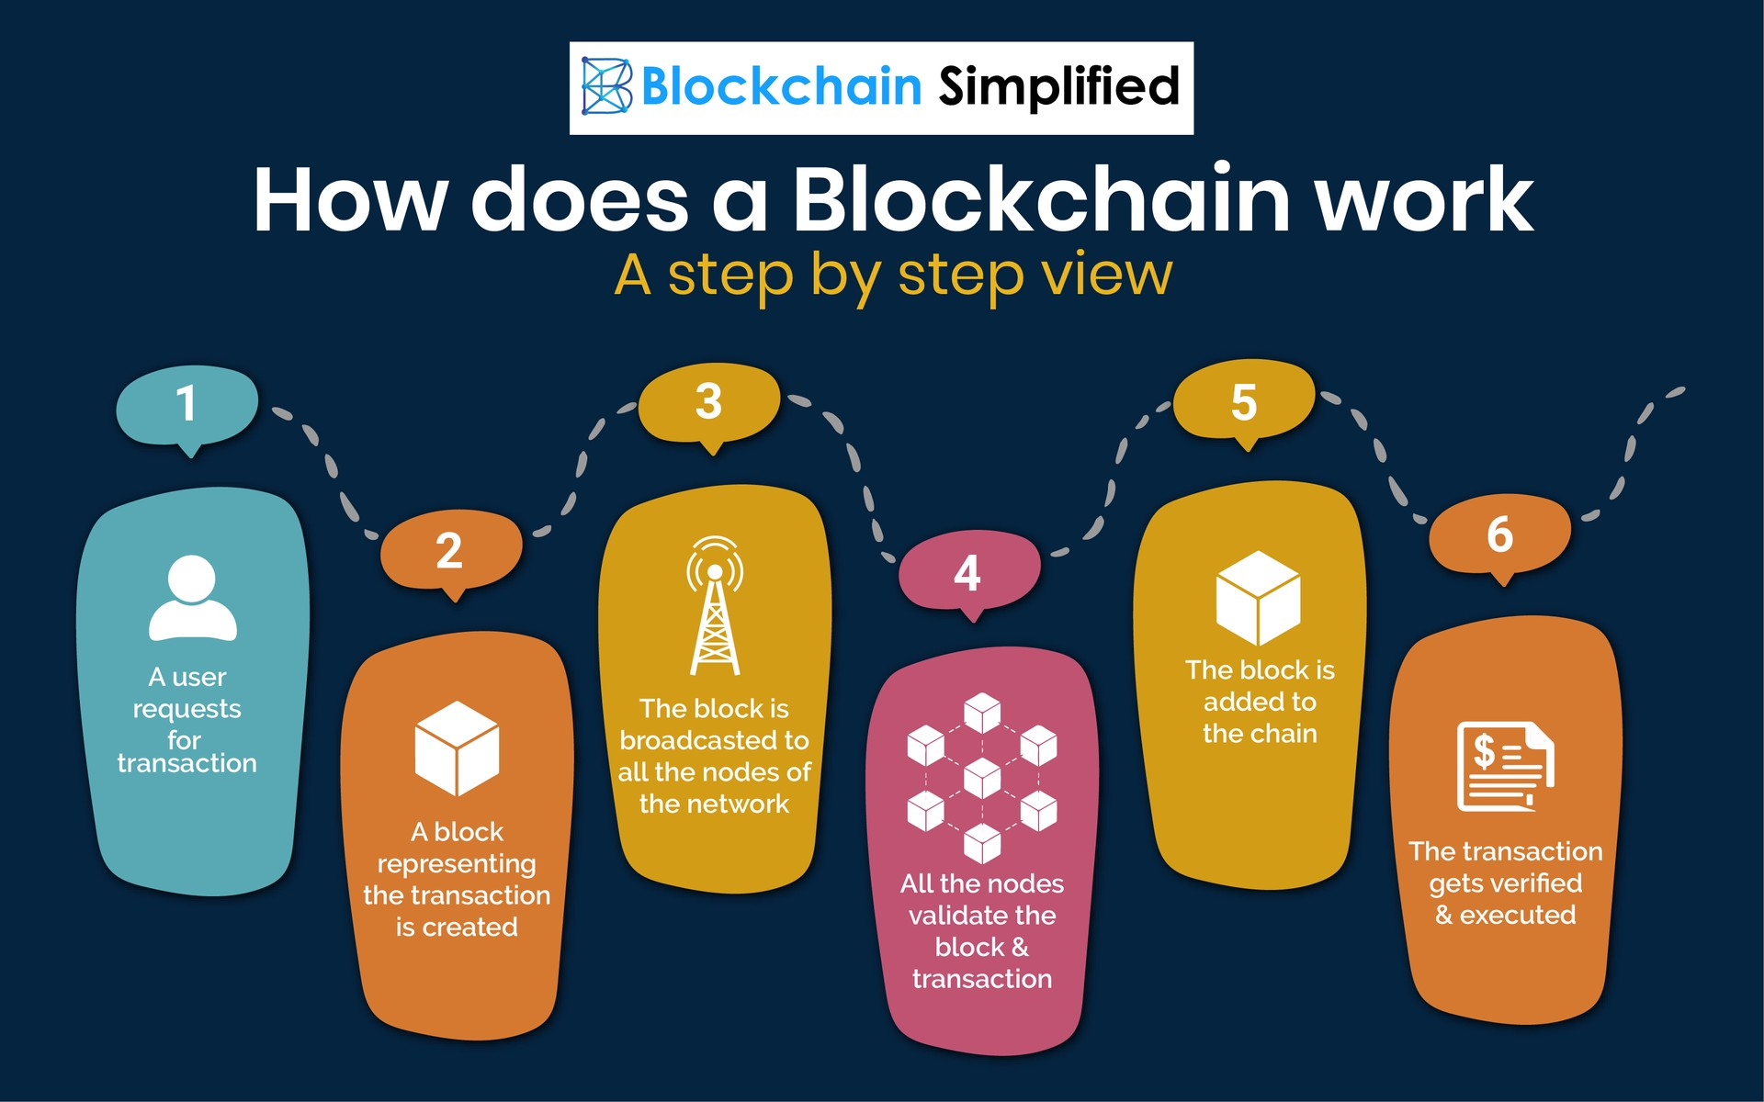
How Blockchain Works ?

Slide 4
Data Structures Used :
Linked List :
Merkle Tree :
Hash Table :

Slide 5
Other implementations :
Merge Sort
OpenSSL library used for SHA256
Socket Programming for Network Connections

Slide 6
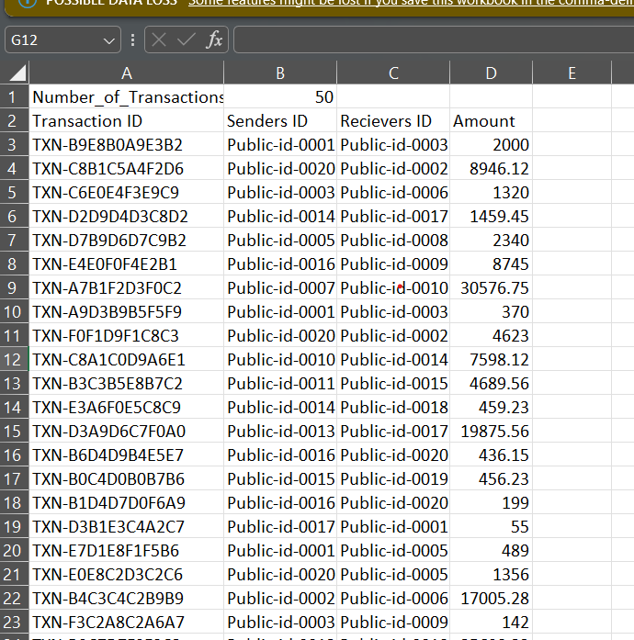
Data Format

Slide 7
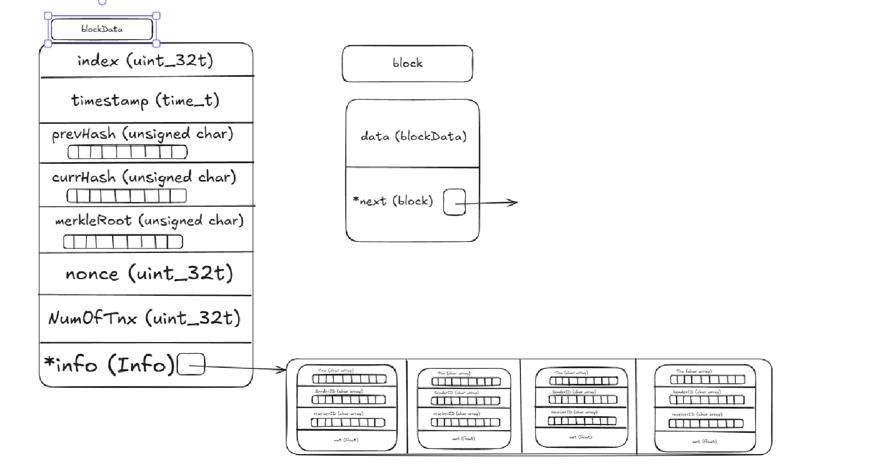
Pointer Diagrams : blockData and Block

Slide 8
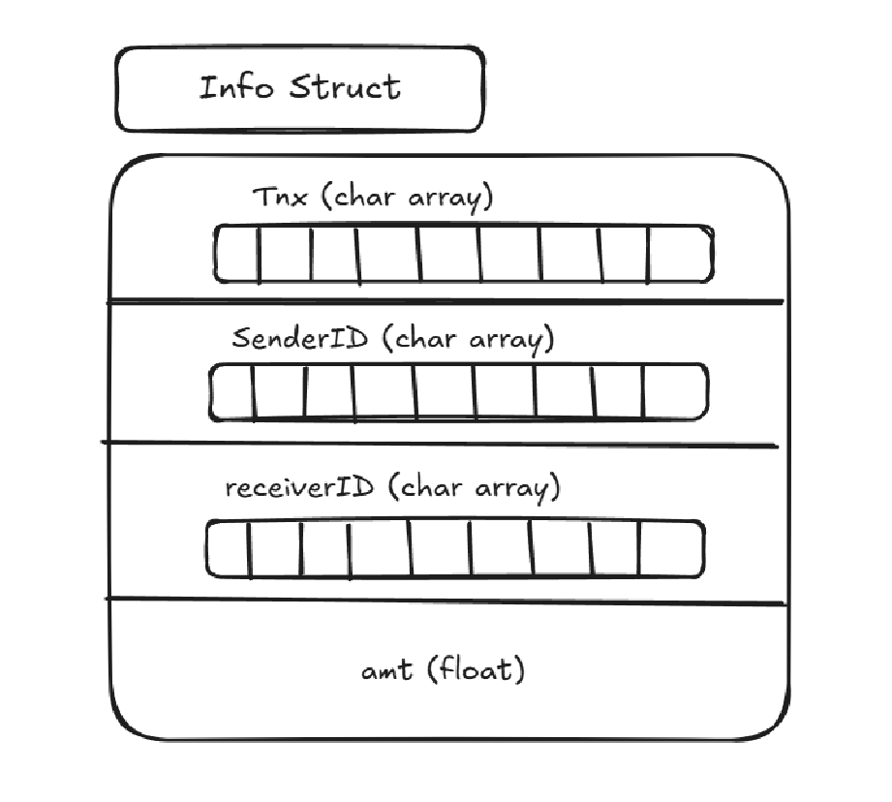
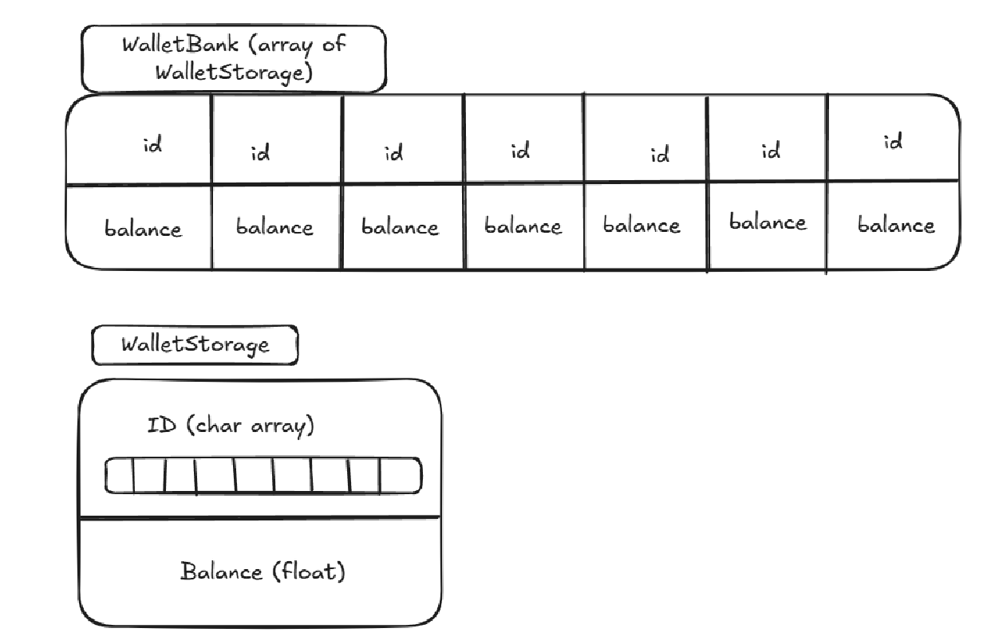
Pointer Diagrams of Structures: Info Structure And Wallet Structure

Slide 9
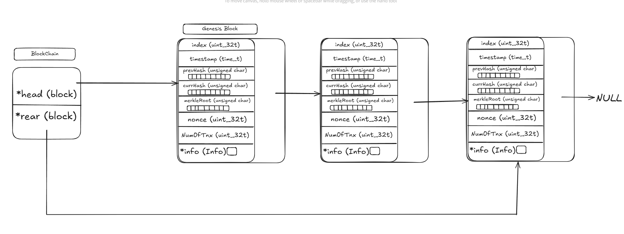
Pointer Diagram: BlockChain

Slide 10
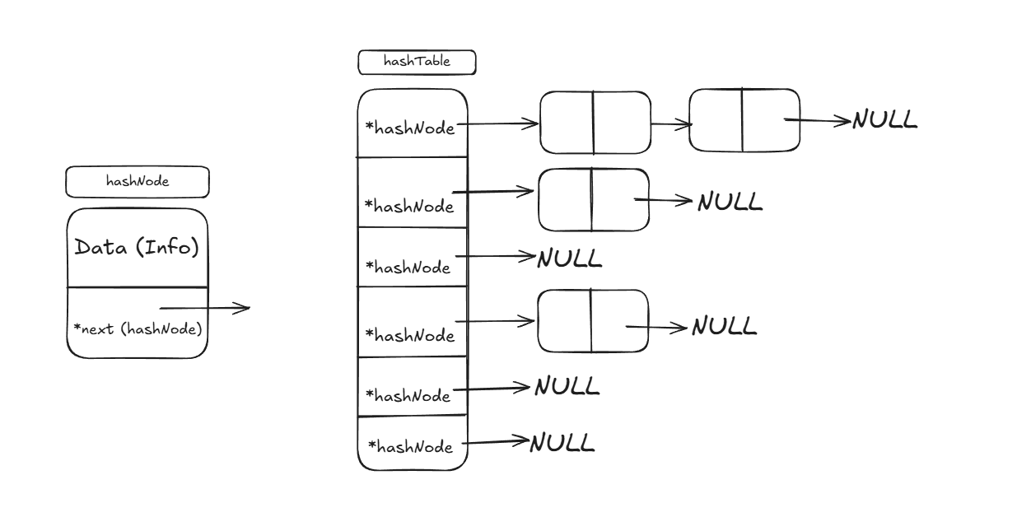
Pointer Diagram : Hash Table

Slide 11
Operations Performed
Add a new Block
Mining Operation
View BlockChain
Validate BlockChain Integrity
Search Transactions
Network Connections

Slide 12
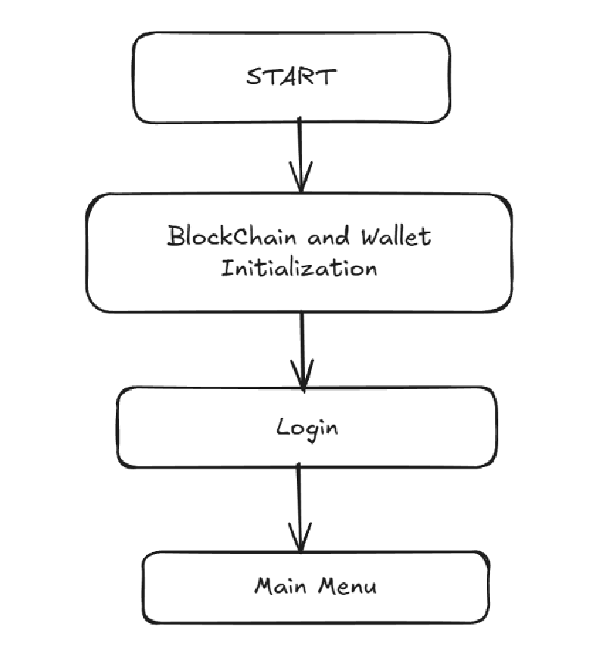
Flow of the Program

Slide 13
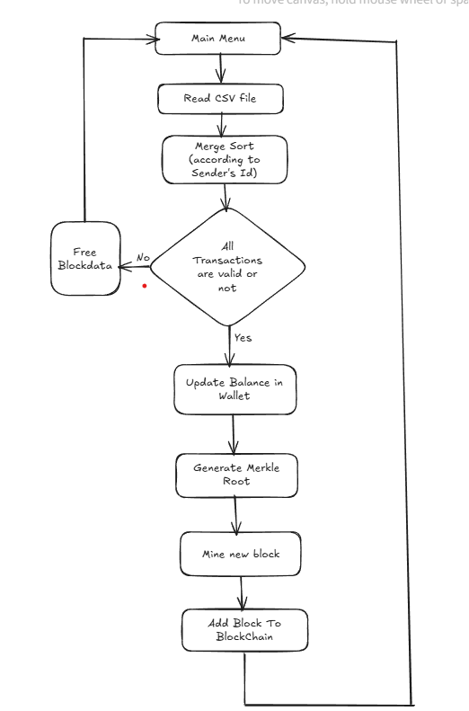
Add A new Block To the Block Chain
1. Read a CSV File
2. Merge Sort (according to sender IDs)
3. Validating all the transaction withing given block
4. Updating Balance in the wallet according to the transactions
5. Generation of Merkel Root
6. Mining of the Block
7. Adding new block to the block chain

Slide 14
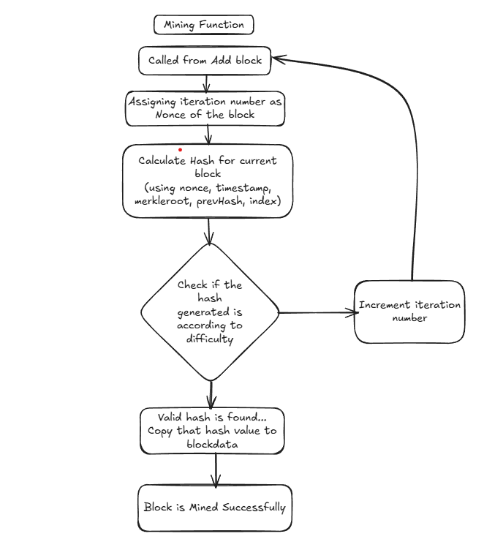
Mining Operation

Slide 15
Validate Block Chain Integrity
If Block Chain empty then returns
For genesis block, checks that index = 1, prev hash is a zero string or not, current hash is correct or not. If not then corruption is found.
Checks till block chain ends :
prev hash of current block == curr hash of previous block
index of current block = index of prev block + 1
check for current hash of every block.
if corruption is found then it will print the block number in which corruption is found

Slide 16
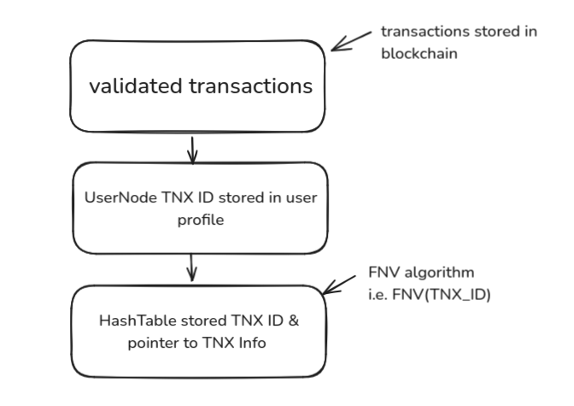
Search Transactions
While adding block, the transaction ids involving transactions of that user node (eg. Public-id-0001) will be hashed and the pointer to transaction details will be stored in the hash table

Slide 17
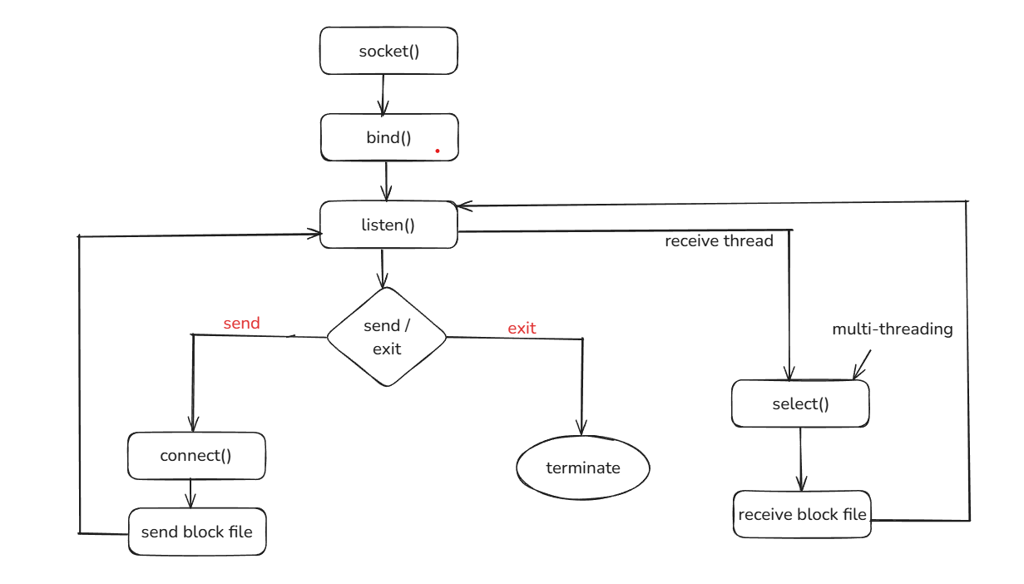
Networking Connections

